Slide 1

Data Science Toolbox:
R Programming
Project
Dataset :-
AirQualityUCI

Slide 2
Dataset Information:-
The dataset contains 9358 instances of hourly averaged responses from an array of 5 metal oxide chemical sensors embedded in an Air Quality Chemical Multisensor Device. The device was located on the field in a significantly polluted area, at road level,within an Italian city. Data were recorded from March 2004 to February 2005 (one year)representing the longest freely available recordings of on field deployed air quality chemical sensor devices responses. Ground Truth hourly averaged concentrations for CO, Non Metanic Hydrocarbons, Benzene, Total Nitrogen Oxides (NOx) and Nitrogen Dioxide (NO2) and were provided by a co-located reference certified analyzer. Evidences of cross-sensitivities as well as both concept and sensor drifts are present as described in De Vito et al., Sens. And Act. B, Vol. 129,2,2008 (citation required) eventually affecting sensors concentration estimation capabilities. Missing values are tagged with -200 value. This dataset can be used exclusively for research purposes. Commercial purposes are fully excluded.

Slide 3
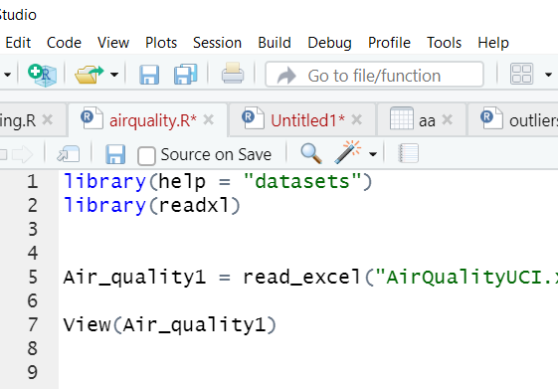
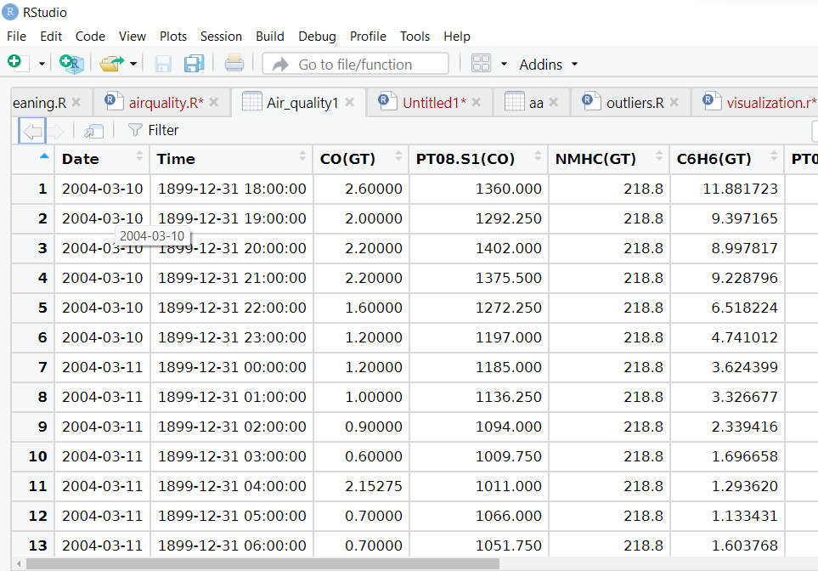
To read the dataset I used following syntax
library(readxl)
Air_quality1 = read_excel("AirQualityUCI.xlsx"
View(Air_quality1)

Slide 4
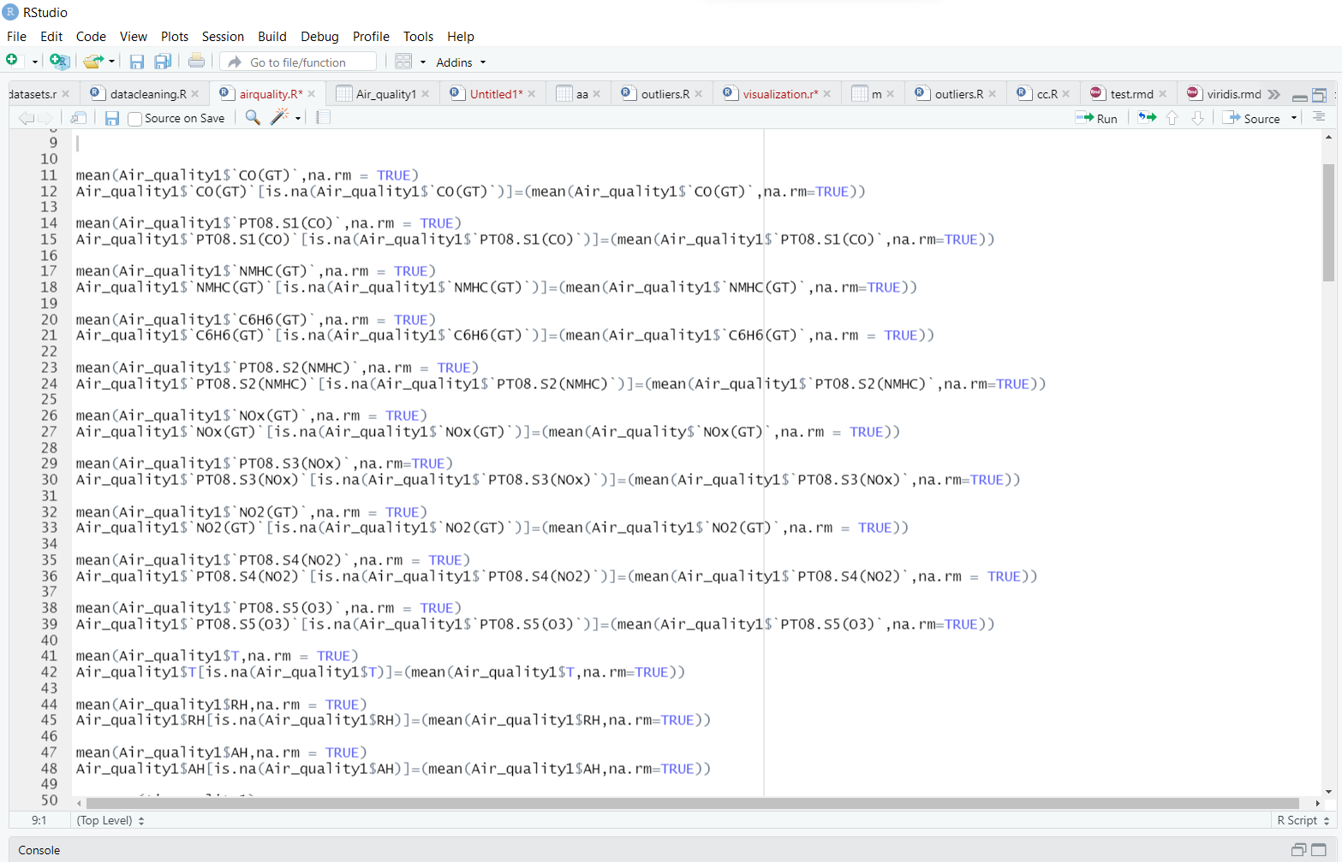
I removed all anomalies and replaced the missing values with mean of that particular columns using “Imputation Method”
Arbitary Value Imputation
This technique states that we group the missing values in a column and assign them to a new value that is far away from the range of that column. Mostly we use values like 99999999 or -9999999 or “Missing” or “Not defined” for numerical & categorical variables. Data is not Missing At Random

Slide 5
Code (using Imputation Method)
mean(Air_quality1$`CO(GT)`,na.rm = TRUE)
Air_quality1$`CO(GT)`[is.na(Air_quality1$`CO(GT)`)]=(mean(Air_quality1$`CO(GT)`,na.rm=TRUE))
mean(Air_quality1$`PT08.S1(CO)`,na.rm = TRUE)
Air_quality1$`PT08.S1(CO)`[is.na(Air_quality1$`PT08.S1(CO)`)]=(mean(Air_quality1$`PT08.S1(CO)`,na.rm=TRUE))
mean(Air_quality1$`NMHC(GT)`,na.rm = TRUE)
Air_quality1$`NMHC(GT)`[is.na(Air_quality1$`NMHC(GT)`)]=(mean(Air_quality1$`NMHC(GT)`,na.rm=TRUE))
mean(Air_quality1$`C6H6(GT)`,na.rm = TRUE)
Air_quality1$`C6H6(GT)`[is.na(Air_quality1$`C6H6(GT)`)]=(mean(Air_quality1$`C6H6(GT)`,na.rm = TRUE))
mean(Air_quality1$`PT08.S2(NMHC)`,na.rm = TRUE)
Air_quality1$`PT08.S2(NMHC)`[is.na(Air_quality1$`PT08.S2(NMHC)`)]=(mean(Air_quality1$`PT08.S2(NMHC)`,na.rm=TRUE))
mean(Air_quality1$`NOx(GT)`,na.rm = TRUE)
Air_quality1$`NOx(GT)`[is.na(Air_quality1$`NOx(GT)`)]=(mean(Air_quality$`NOx(GT)`,na.rm = TRUE))

Slide 6
After replacing the missing Values I checked all the outliers in the dataset. I used winsorizing method to remove “Outliers”.
Outliers
Outliers are extreme values that differ from most other data points in a dataset. They can have a big impact on your statistical analyses and skew the results of any hypothesis tests.
Winsorizing
Winsorization is the process of replacing the extreme values of statistical data in order to limit the effect of the outliers on the calculations or the results obtained by using that data. The mean value calculated after such replacement of the extreme values is called winsorized mean
IQR
The interquartile range defines the difference between the third and the first quartile. Quartiles are the partitioned values that divide the whole series into 4 equal parts. So, there are 3 quartiles. First Quartile is denoted by Q₁ known as the lower quartile, the second Quartile is denoted by Q₂ and the third Quartile is denoted by Q₃ known as the upper quartile. Therefore, the interquartile range is equal to the upper quartile minus lower quartile.

Slide 7
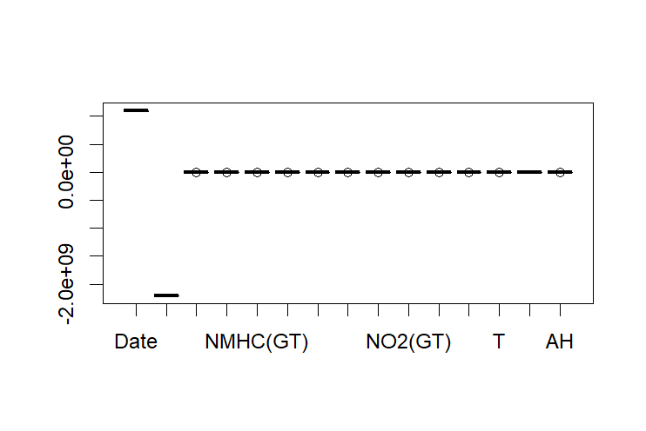
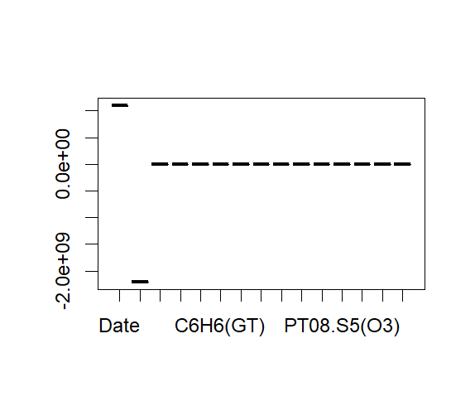
Code (Using Winsorizing method)
Before removing outliers
summary(Air_quality1)
length(Air_quality1)
boxplot(Air_quality1)
r1=2.600+1.5*IQR(Air_quality1$`CO(GT)`)
r2=1.200-1.5*IQR(Air_quality1$`CO(GT)`)
Air_quality1$`CO(GT)`[Air_quality1$`CO(GT)`>r1]=r1
Air_quality1$`CO(GT)`[Air_quality1$`CO(GT)`<r2]=r2
Air_quality1
summary(Air_quality1)
boxplot(Air_quality1)
boxplot(Air_quality1$`CO(GT)`)
After removing outliers

Slide 8
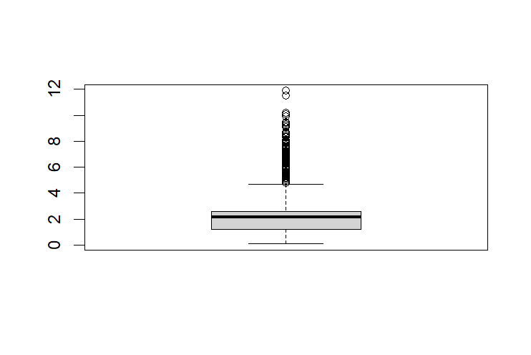
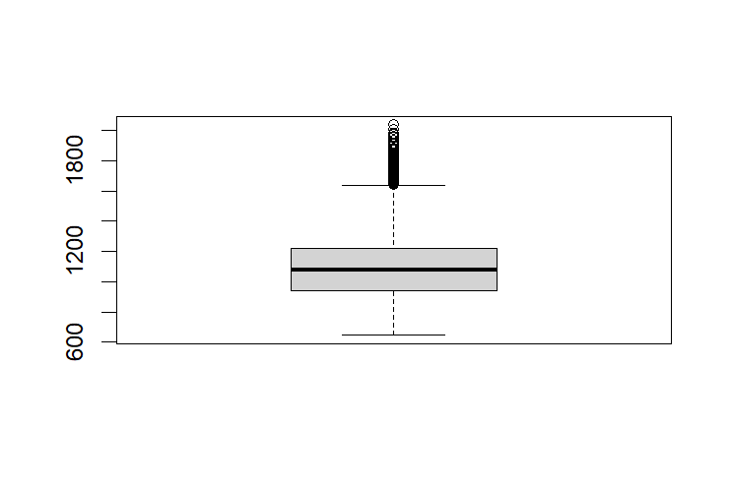
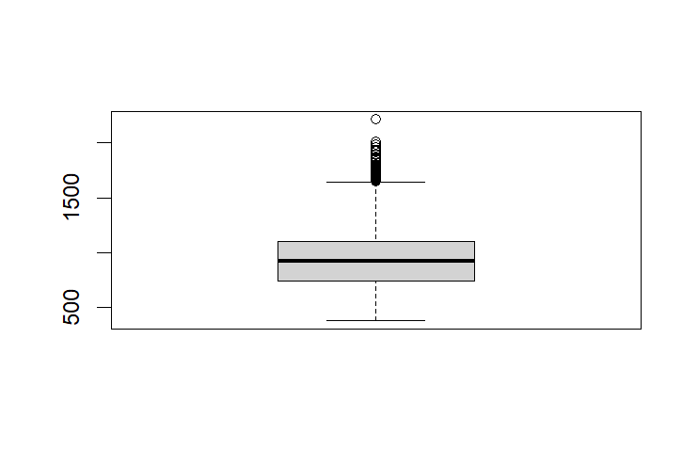
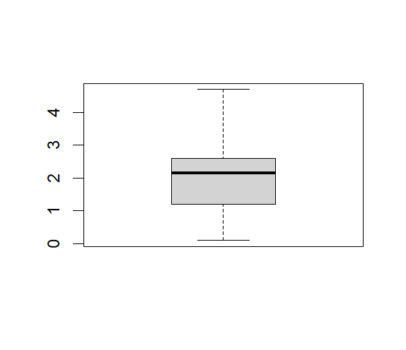
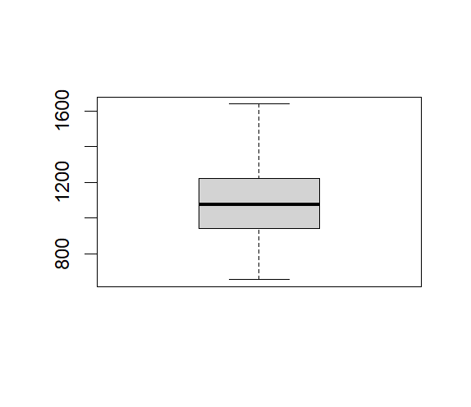
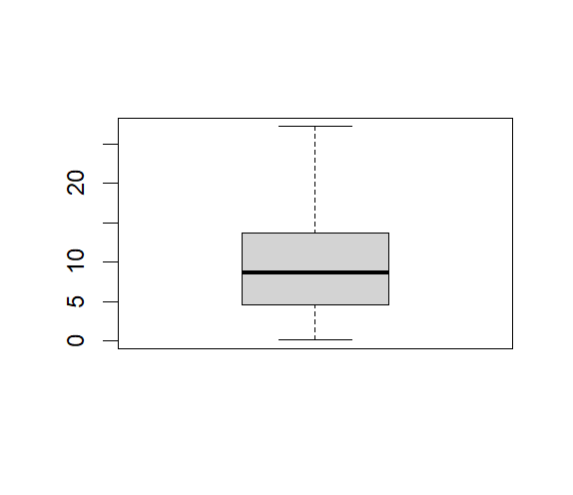
Some Boxplots Before removing outliers
Some Boxplots After removing outliers

Slide 9
After removing Outliers I represented the data with graphical representation like Histogram, dropchat, Scatterplot, bwplot, barchart & densityplot.
Histogram
A histogram is a graphical representation of a grouped frequencydistribution with continuous classes. It is an area diagram and canbe defined as a set of rectangles with bases along with the intervalsbetween class boundaries and with areas proportionalto frequencies in the corresponding classes.
Dotchart
dotchart() function in R Language is used to create a dot chart of the specified data. A dot chart is defined as a plot which is used to draw a Cleveland dot plot.
ScatterPlot
Scatter plots are the graphs that present the relationship between two variables ina data-set. It represents data points on a two-dimensional plane or on aCartesian system. The independent variable or attribute is plotted on the X-axis, while the dependent variable is plotted on the Y-axis. These plots are often called scatter graphs or scatter diagrams.

Slide 10
BWPlot
The function bwplot () makes box-and-whisker plots for numerical variables. It comes from the lattice package for statistical graphics, which is pre-installed with every distribution of R.
BarChart
A bar chart represents data in rectangular bars with lengthof the bar proportional to the value of the variable.R uses the function barplot () to create bar charts.
DensityPlot
A density plot is a representation of the distribution of a numeric variable that uses a kernel density estimate to show the probability density function of the variable. In R Language we use the density () function which helps to compute kernel density estimates. And further with its return value, is used to build the final density plot.

Slide 11
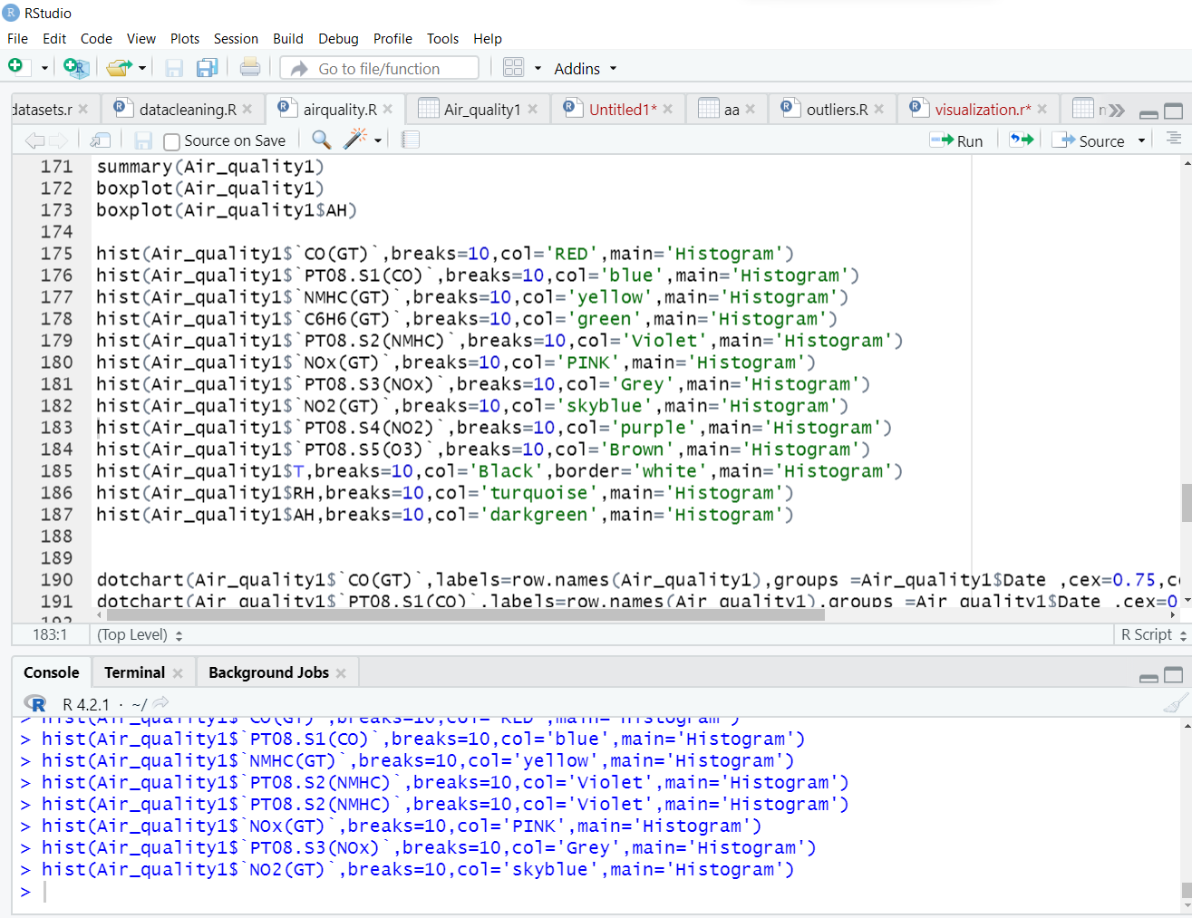
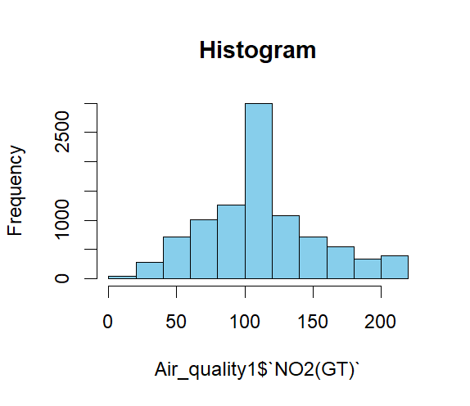
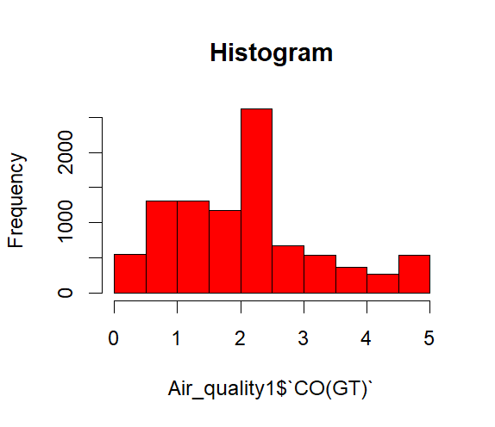
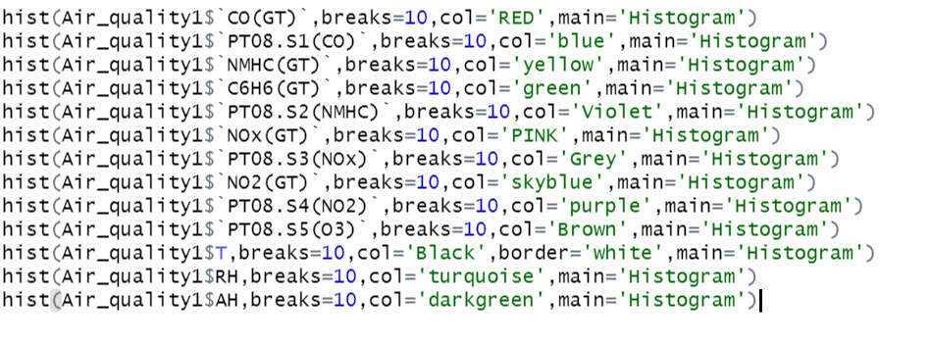
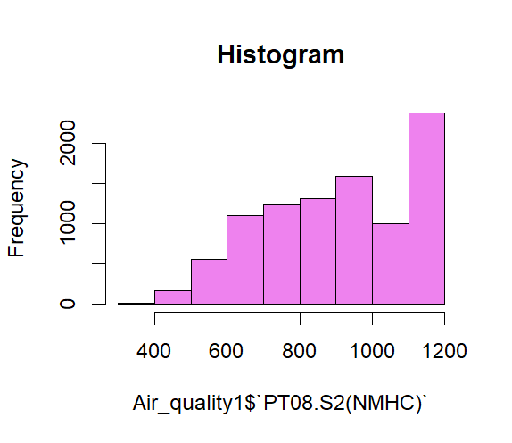
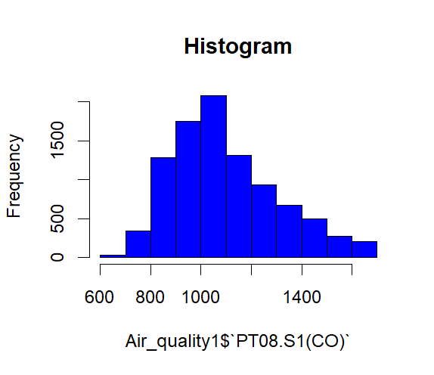
Histogram

Slide 12
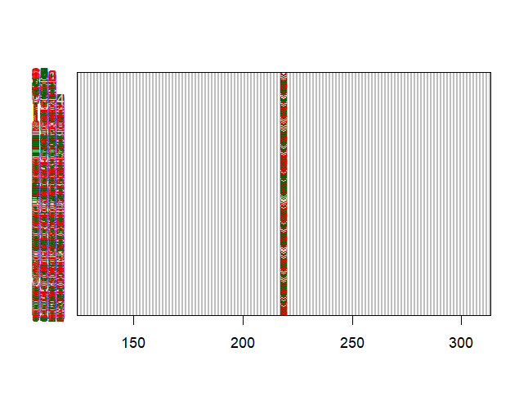
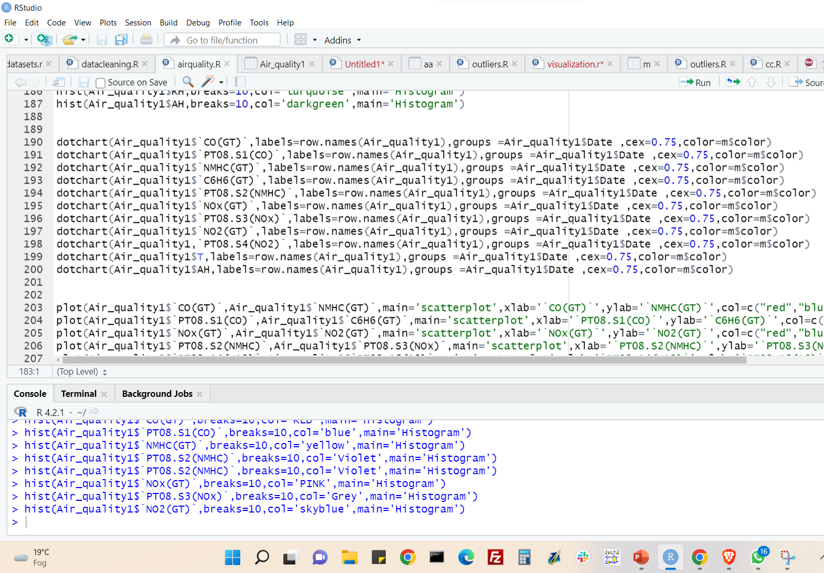
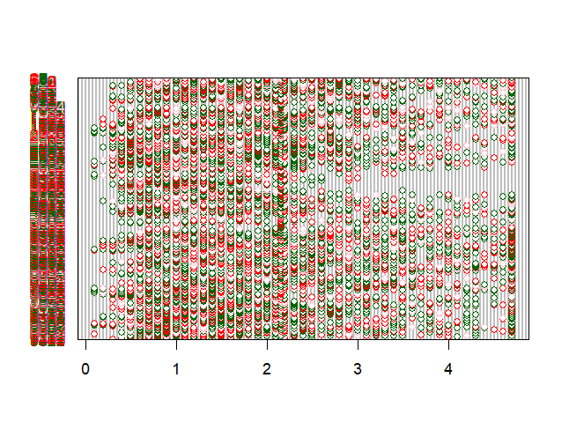
Dotchart

Slide 13
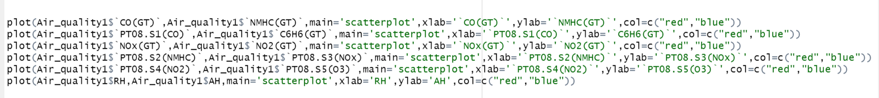
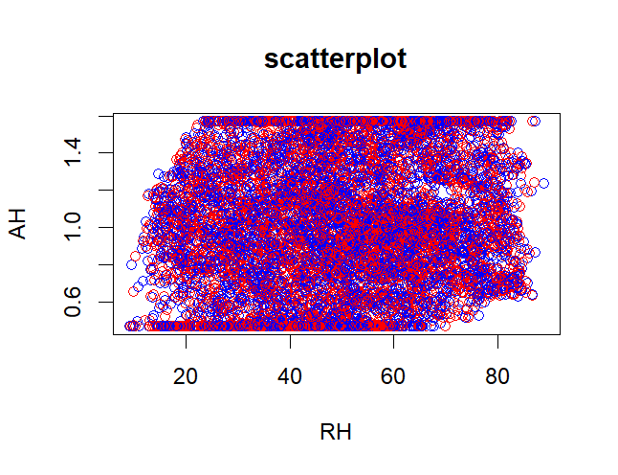
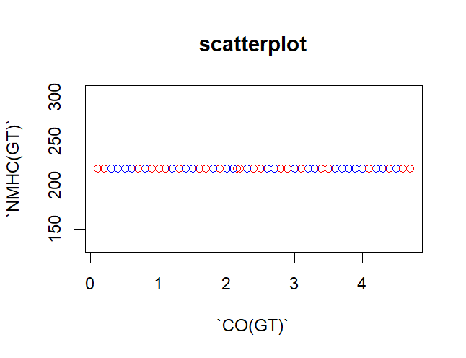
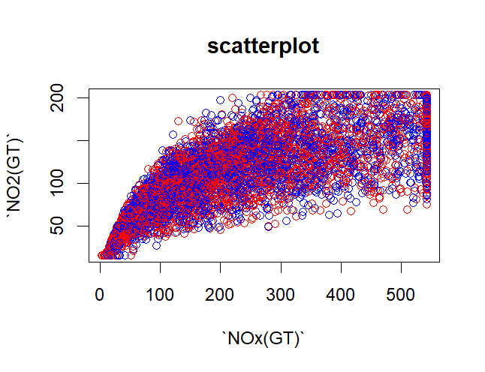
ScatterPlot

Slide 14
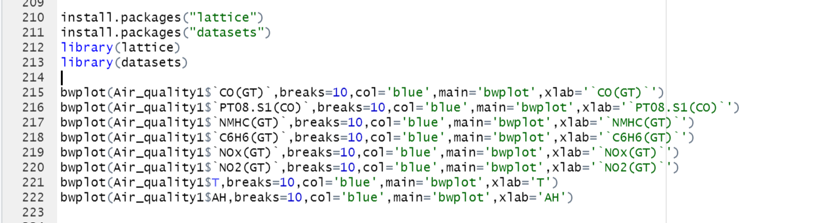
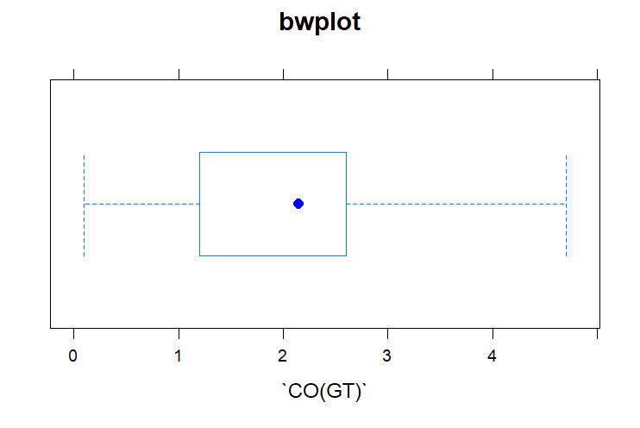
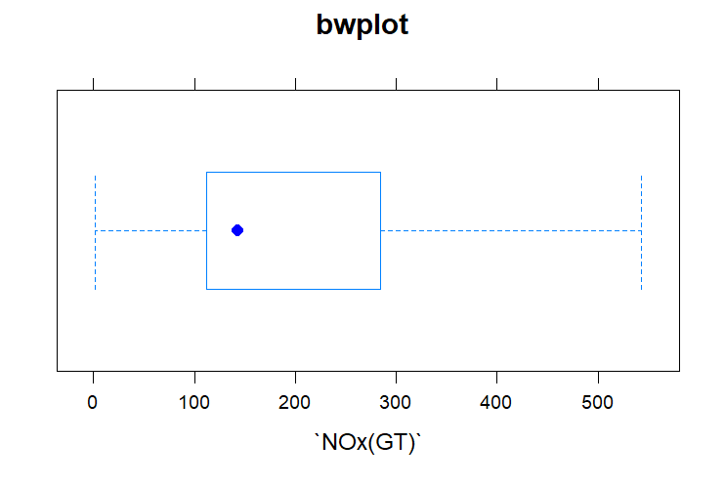
BWPlot

Slide 15
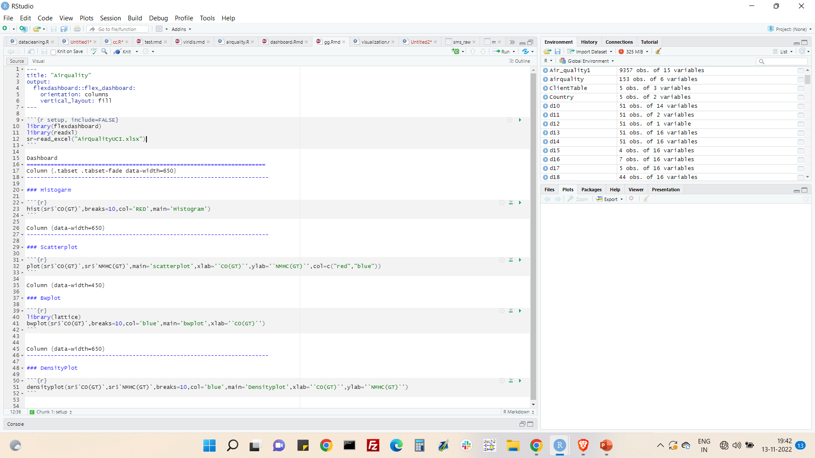
Dashboard

Slide 16
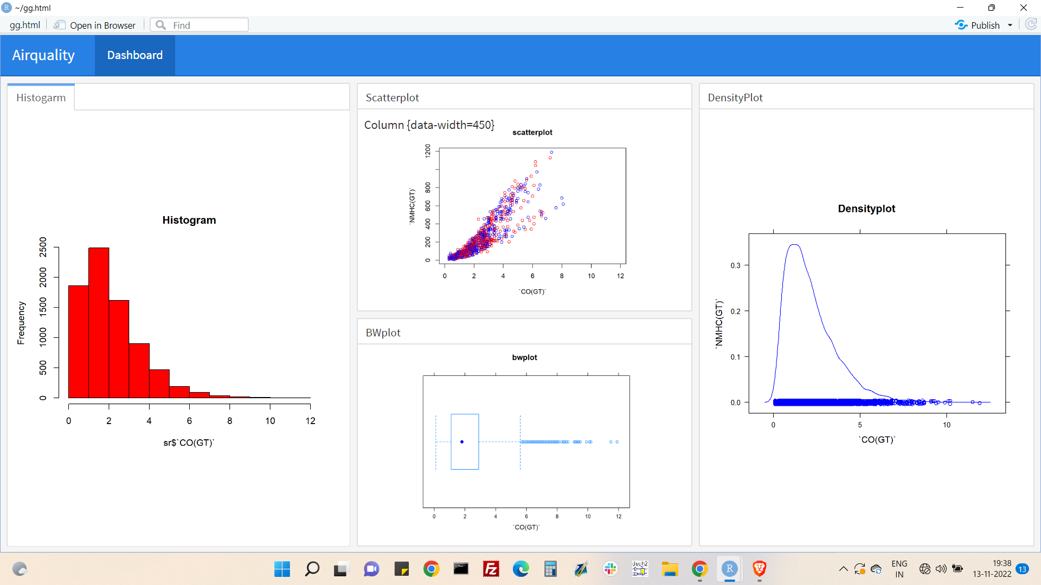

Slide 17
Conclusion:-
In this Project I learned about data Visualization and data analysis with datasets in r programming.
R is a Programming Language that is mostly used for machine learning, data analysis, and statistical computing. It is an interpreted language and is platform independent that means it can be used on platforms.
I have worked on imputation method ,winsorizing method and analyze the data with lots of graphical representations.

Slide 18

THANK YOU
.

